Slide 1
ACADEMIC WRITING
OPINION ESSAY
Логвиненко Елена Валерьевна
Учитель английского языка ОАНО «СШ «ЦО Столичный»

Slide 2
KINDS OF ESSAY
Expressing opinions (о Вашем мнении),
Advantages/Disadvantages (достоинства и недостатки),
Providing Solutions (решение каких-либо проблем),
Discursive Essay (где Вас просят рассмотреть определенную тему с разных точек зрения).

Slide 3
Opinion essay
Если в конце задания спрашивается, согласны Вы или нет, или в какой степени Вы согласны (Do you agree or disagree, to what extent do you agree?), то это сочинение должно быть полностью о Вашем мнении. Во вступлении Вы должны перефразировать тему задания, используя другие конструкции и синонимы, и обозначить свое мнение – согласны Вы или нет. В IELTS Academic Вам нужно будет еще добавить в какой степени (I agree/disagree completely/partly). А в последующих абзацах нужно доказывать, что Ваше мнение верно, объясняя причины и давая наглядные примеры. В заключении от Вас ожидают подведение итогов, но с использованием других слов-синонимов.

Slide 4
OPINION ESSAY SCHEME
INTRODUCTION
MY OPINION WITH 2-3 ARGUMENTS
OPPONENTS OPINION WITH 1 ARGUMENT
MY DISAGREEMENT WITH IT
CONCLUSION

Slide 5
INTRODUCTION
INTRODUCTION
PARAPHRASE THE THEME
1. Nowadays many people face a difficult decision when they…
2. There is no doubt that _________ is one of the most pressing issues in the modern world.
3. One issue that has caused lots of controversy over the years is ________________.
4. Whether it is true or false , it is the question of constant debates.
5. Advocates and opponents haven’t arrived at a common idea.
6. Many people are convinced that ___________ while others don’t agree with them.
7. This question has always worried people and the answer to it is not simple.
8. Who is right?

Slide 6
Some people believe that it is impossible to overcome differences between members of different generations. Do you agree with this statement? What is your opinion?
EXAMPLE

Slide 7
INTRODUCTION
There is no doubt that the problem of parents and children is one of the most pressing issues in the modern world. Some people are convinced that teenagers can’t communicate with their grandparents while others don’t agree.

Slide 8
Computer games teach us nothing and young people should avoid them
ESSAY TASK

Slide 9
INTRODUCTION
One issue that has caused lots of controversy over the last years is computer and video games. Whether it is true or false , it is the question of constant debates.

Slide 10
MY OPINION 2
Personally I am for/ against ______.
I strongly believe that ________ is good/bad.
In my opinion,
To my mind,

Slide 11
Computer and video games teach us nothing and young people should avoid them.
Personally I am for computer games.
I strongly believe that computer and video games are extremely bad for teenagers.

Slide 12
ADVANTAGES /DISADVANTAGES
Computer games require a great deal of patience. | Computer games depict violence, sexual themes, consumption of drugs, alcohol or tobacco, and bad language
Computer games can increase players attention capacities. | Computer games encourage violent behaviour, blur the difference between right and wrong and cause addiction.
Computer games can improve child’s visual skills and develop coordination. | Computer games make children unsociable and passive
Computer games promote the development of strategic thinking and planning skills. | The levels of obesity among gamers are rising.
Computer games help children develop math, reading skills and spelling through play. | Computer games can cause blood pressure, heart disease, and negative influence on children’s psyche.
It has been noticed that gamers don’t realize they are learning. | People play computer games to escape real life problems and live virtual life.

Slide 13
ARGUMENTS for my opinion
Phrases
To begin with,
To start with,
Firstly,
Linking phrase + one argument with example

Slide 14
Personally I am for computer games. To start with, (1 argument) computer and video games have educational effect for example, they help children develop math, reading skills and spelling through play. And gamers don’t realize they are learning.

Slide 15
Фразы, добавляющие новые аргументы
Furthermore, Secondly,
Moreover, Besides,
Thirdly, Finally,
Linking phrase + 2nd argument with example.
Linking phrase + 3rd argument with example. (not necessary )

Slide 16
2 and 3 arguments
Moreover, (2nd argument) computer games promote the development of strategic thinking and planning skills. That can help students at school at math and science subjects. Finally, (3rd argument) some games require a great deal of patience that is very helpful for pupils to sit at the lesson for 45 minutes and do homework at home.

Slide 17
OPPONENTS OPINION WITH 1 ARGUMENT
MY DISAGREEMENT WITH IT
Phrases for the opponent’s opinion.
Some people argue that ________ is good/bad.
However, many people are against this point of view.
On the other hand, there are people who don’t agree with it. They say/think ( 1 opponent’s argument)

Slide 18
OPPONENTS OPINION WITH 1 ARGUMENT
However, many people are against this point of view. They think (1 argument) computer games depict violence, sexual themes, consumption of drugs, alcohol or tobacco, and bad language.

Slide 19
My disagreement with opponent’s opinion
I disagree with this point of view because…
Contrary to what the most people believe, I think ….
I completely disagree with this statement.
Personally, I strongly object to this statement

Slide 20
OPPONENTS OPINION WITH 1 ARGUMENT
MY DISAGREEMENT WITH IT
Personally, I strongly object to this statement, because they are mostly talking about adults’ games and nowadays there is a strict rule of games’ age limits.

Slide 21
CONCLUSION
To sum up,
To summarize,
In conclusion, I would like to emphasize that tastes differ…
So it is up to you to decide whether it is good or bad.

Slide 22
CONCLUSION
To sum up, it is up to you to decide whether computer games are good or bad. All we should do is to control the playing, and the time must be strictly limited. The thing is to find the right balance in using them.

Slide 23
One issue that has caused lots of controversy over the last years is computer and video games. Whether it is true or false , it is the question of constant debates. (30)
Personally I am for computer games. To start with, computer and video games have educational effect for example, they help children develop math, reading skills and spelling through play. And children don’t realize they are learning. Moreover, computer games promote the development of strategic thinking and planning skills. That can help teenagers at school at math and science subjects. Finally, some games require a great deal of patience that is very helpful for pupils to sit at the lesson for 45 minutes and do homework at home. (87)
However, many people are against this point of view. They think computer games depict violence, sexual themes, consumption of drugs, alcohol or tobacco, and bad language. Personally, I strongly object to this statement, because they are mostly talking about adults’ games and nowadays there is a strict rule of games’ age limits. (52)
To sum up, it is up to you to decide whether playing computer games is good or bad. All we should do is to control the playing, and the time must be strictly limited. The most important thing is to find the right balance in using them. (47)
(216 words)

Slide 24
One issue that has caused lots of controversy over the last years is computer and video games. Whether it is true or false , it is the question of constant debates. (30)
Personally, I think computer games are bad for children. To start with, computer games encourage violent behaviour, blur the difference between right and wrong and cause addiction. There are lots of examples when teenagers confuse virtual world with real life and start killing people. Moreover, computer games make children unsociable and passive and the level of obesity among such children is rising. Yet, games can cause blood pressure, heart disease, and negative influence on children’s psyche. (76)
On the other hand, some people say that computer games are helpful for children. They say computer and video games have educational effect for example, they help children develop math, reading skills and spelling through play. I totally disagree with them because teenagers would rather prefer playing entertaining games than educational ones. (52)
To sum up, it is up to you to decide whether playing computer games is good or bad. All we should do is to control the playing, and the time must be strictly limited. The most important thing is to find the right balance in using them. (47)
205 words

Slide 25
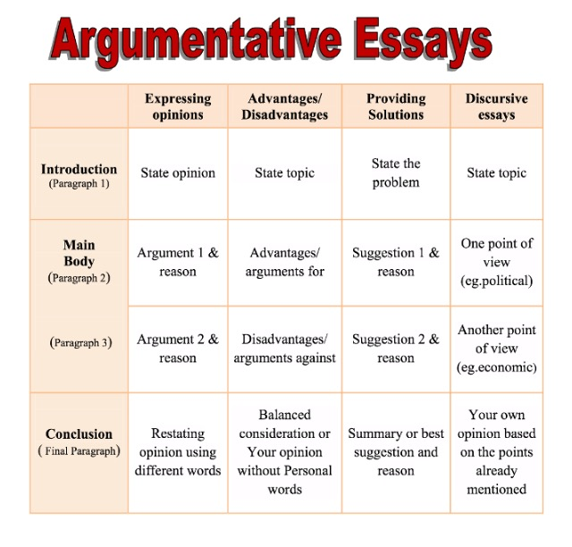

Slide 26
Advantages/Disadvantages
Данное сочинение должно быть более нейтральным, т.е. конкретно Ваше мнение здесь обычно не спрашивают. Вас попросят проанализировать достоинства и недостатки чего-нибудь (например, проживания в большом городе). Во вступлении Вам опять следует также обозначить тему другими словами (Помните, что если Вы используете те же слова, что и в задании, Вам их засчитывать не будут). Второй абзац можно посвятить преимуществам, а третий — недостаткам. В заключении Вы должны сделать вывод — выразите свое мнение, но без strong language, то есть без сильной эмоциональной окраски (hate, cannot stand, и т.д.).

Slide 27
Providing Solutions
В задании обозначена проблема, и Вас просят предложить решения для нее. В введении Вам следует объяснить, почему это является проблемой, каковы причины и последствия. Во втором абзаце Вы можете предложить первое решение и объяснить, как оно может помочь. Третий абзац рекомендуют посвятить второму альтернативному решению, опять же с примерами. В заключении выбрать лучшее решение, подвести итог и объяснение. Также, возможно высказать свое мнение, помогут ли эти решения и как быстро.

Slide 28
Discursive Essays
Рассмотреть проблему с разных точек зрения, например финансирование исследования космоса с точки зрения политики, экономики и населения страны. Встречается в IELTS Academic. Во вступлении формулируется тема с уточнением того, что многие люди оценивают ее по-разному. Во втором абзаце — рассматривается проблема с одной точки зрения (скажем, политической), подкрепляя основной тезис примерами и причинами. В третьем — с другой, например, экономической точки зрения. В заключении Вы можете поделиться своим мнением, придерживаясь при этом нейтрально — официального стиля.

